Slide 1
Retrieval dialogue system
based on pre-training model

Slide 2
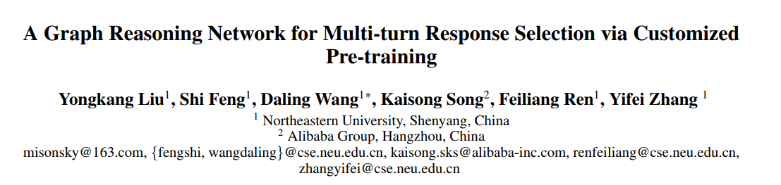
AAAI 2021

Slide 3
Motivation
Existing studies pay more attention to the matching between utterances and responses by calculating the matching score based on learned features, leading to insufficient model reasoning ability.
The challenges of this new task include:
how to identify the clue words in utterances, which is fundamental for inference;
how to conduct inference according to the clue words in utterances.

Slide 4
Contributions
We introduce two customized pre-training methods NUP and UOP, which are specially designed for response selection.
We propose a graph neural network, UDG, which can capture the clue word dependency between utterances and realize reasoning by propagating messages along various utterance paths.
We integrate a graph reasoning network with a self-attention based sequence reasoning network in an end-to-end framework. The empirical results show that our proposed model outperforms the strong baseline methods by large margins on both MuTual and MuTualplus datasets

Slide 5
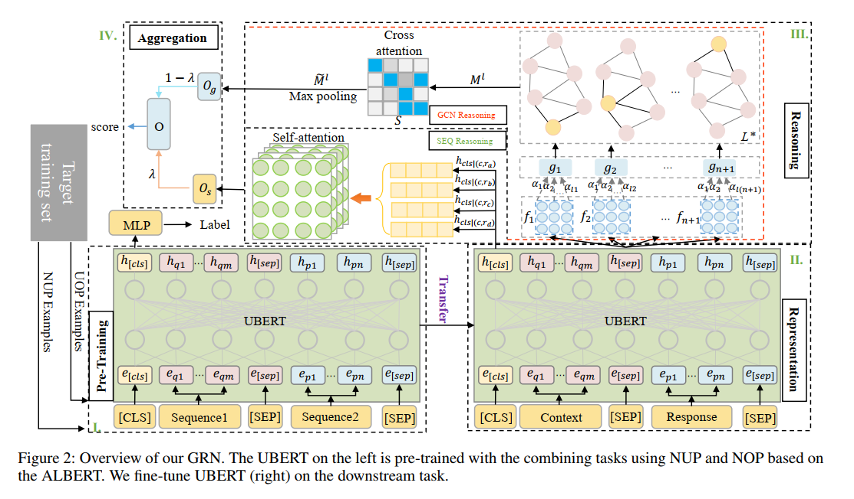
Model Overview

Slide 6




Model Architecture
Pre-Training
ALBERT(Gururangan et al. 2020)
Utterance order prediction (UOP) We consider all utterances as a whole. We want our model to identify which utterance sequences are ordered and which are disordered. Concretely, the ordered sequences are labeled as pos-seq and the randomly shuffled utterance sequences are labeled as neg-seq.
Next utterance prediction (NUP) Concretely, in choosing an utterance at random from utterances U, where 1< i< n, the left part of U is denoted as and right part is denotes as . We require the model to distinguish the pair from the pair.

Slide 7

Model Architecture
Representation
input：
position：
output： , H

Slide 8
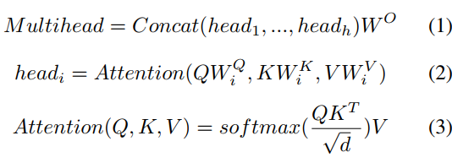
Model Architecture
Reasoning
Sequence structure Reasoning In this paper, we consider selecting the most suitable response by comparing four candidates responses. Therefore, we add a multi-head self-attention (Vaswani et al. 2017) layer on top of the concatenation of all [CLS].

Slide 9

Model Architecture
Reasoning
Sequence structure Reasoning The motivation for adding a multi-head self-attention across the special token [CLS] generated from different candidate responses with utterances is to encourage the further interaction between utterances and candidate responses by comparing four candidate responses, which can generate a better representation for selecting a proper response.
Output:

Slide 10

Model Architecture
Reasoning
Graph Structure Reasoning In this paper, we employ GCN to summarize the local feature information. We propose to build a graph model over utterance representations to explicitly facilitate reasoning over all utterances. The graph node is initialized by the utterance representations .
To build the connections among graph nodes, we design two types of edges based on the dependencies between utterances. We named the constructed graph UDG, taking utterances as nodes.

Slide 11
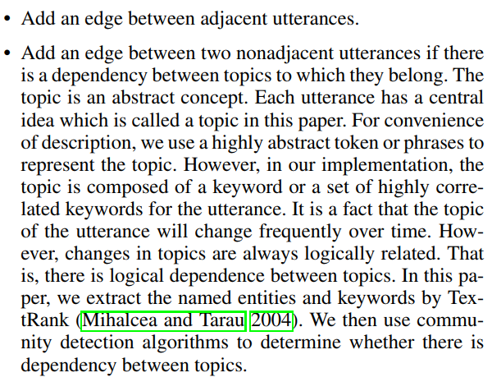
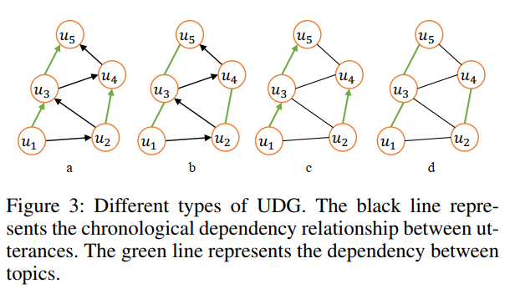
Model Architecture
Reasoning
Graph Structure Reasoning

Slide 12
Model Architecture
Reasoning
Graph Structure Reasoning

Slide 13
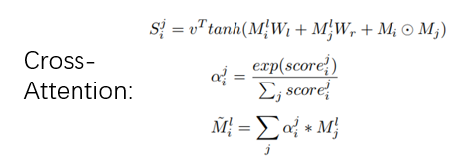
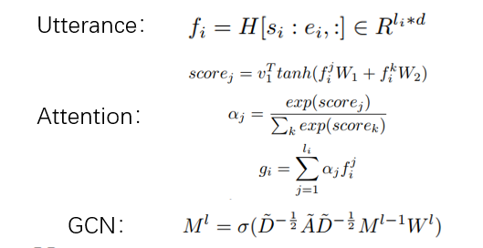

Model Architecture
indirect weak interaction is determined for nonadjacent nodes by a graph convolutional rule. Cross-attention encourages the model to reason based on global information.
Reasoning
Graph Structure Reasoning
Max-Pooling

Slide 14
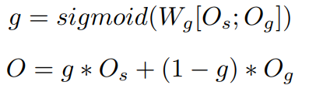

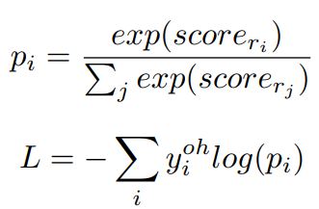
Model Architecture
Aggregation
Loss Function:

Slide 15

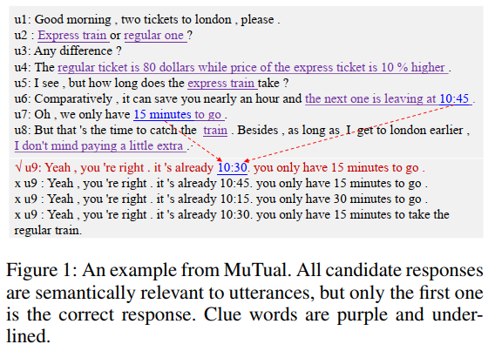
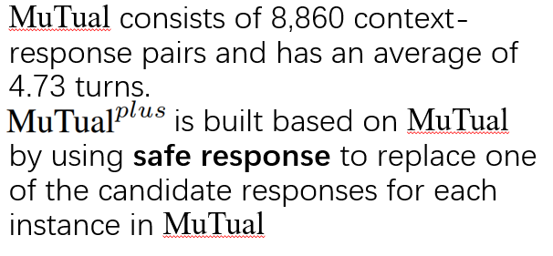


Experiments
Dataset: (1) MuTual; (2) MuTual.
Metrics: (1) ; (2) ;(3)MRR.
Baseline: (1) Basic Models ; (2) MRC Methods; (3) Multi-choice Method

Slide 16
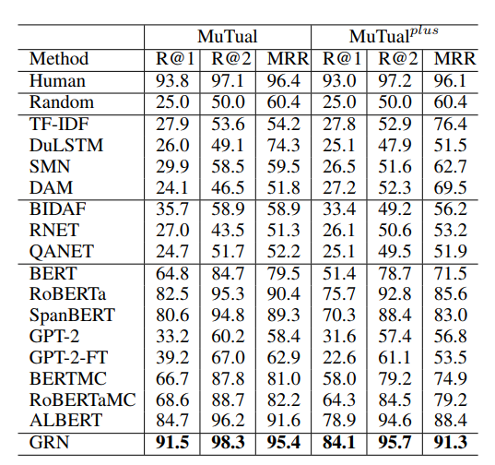
Main Results

Slide 17
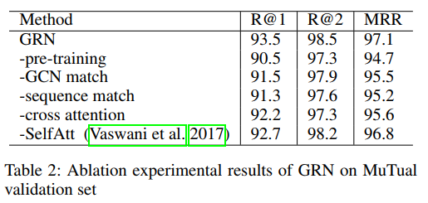
Ablation Study

Slide 18
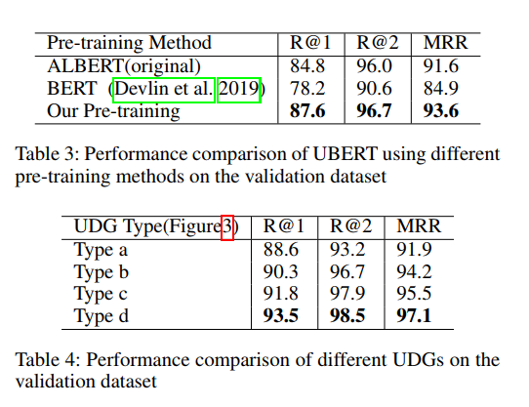
Pre-training method discussion &Number of GCN layers discussion

Slide 19
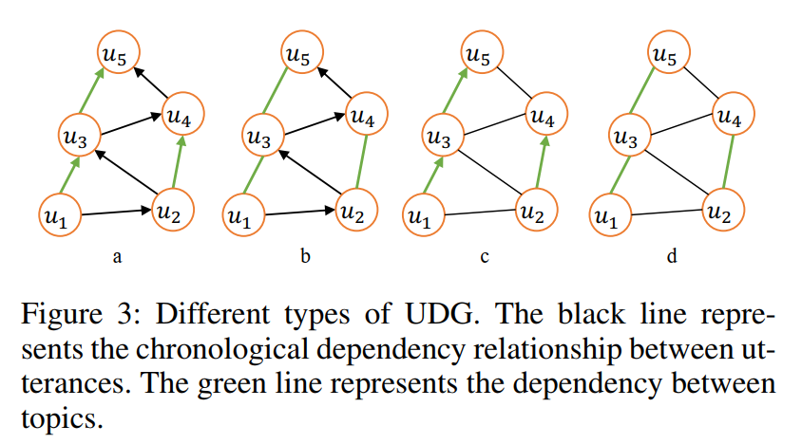

Slide 20
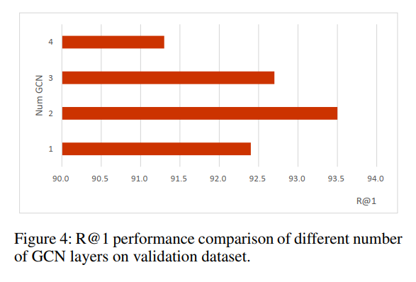
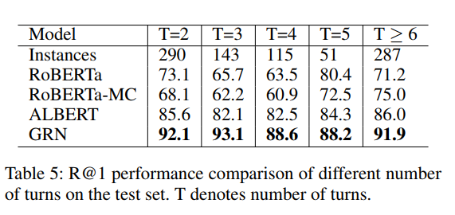
UDG discussion &Performance across different context lengths

Slide 21
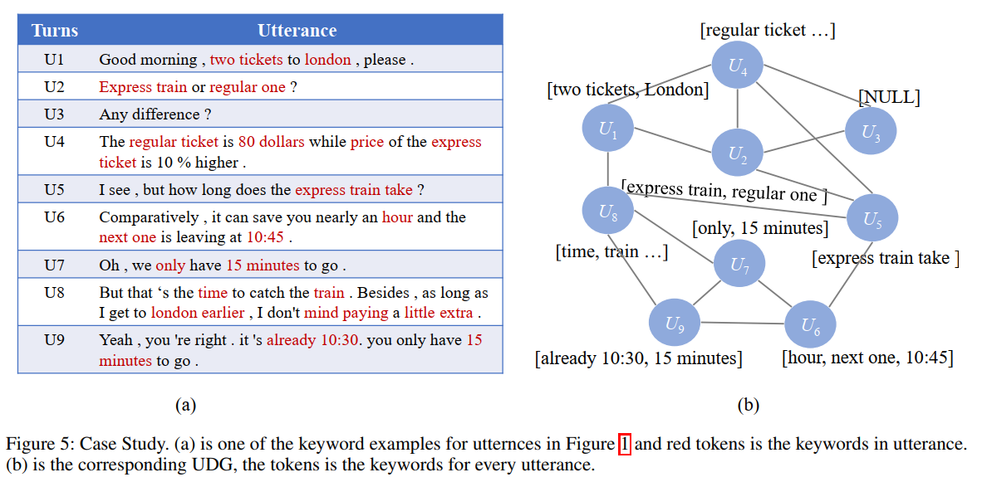

Slide 22
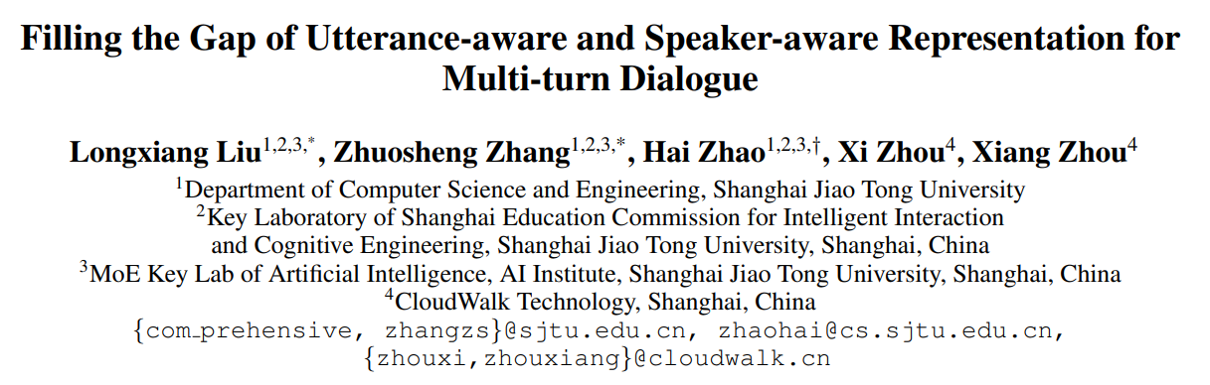
AAAI 2021

Slide 23
Motivation
A multi-turn dialogue is composed of multiple utterances from two or more different speaker roles. Thus utterance-and speaker-aware clues are supposed to be well captured in models. However, in the existing retrieval-based multi-turn dialogue modeling, the pre-trained language models (PrLMs) as encoder represent the dialogues coarsely by taking the pairwise dialogue history and candidate response as a whole, the hierarchical information on either utterance interrelation or speaker roles coupled in such representations is not well addressed.

Slide 24
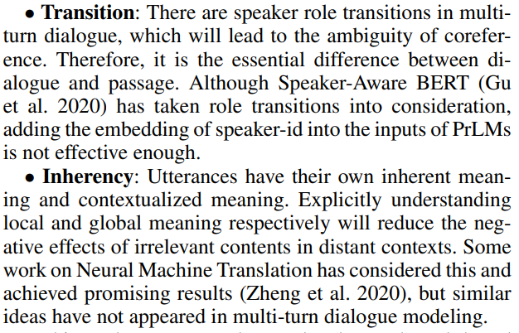
Challenges

Slide 25
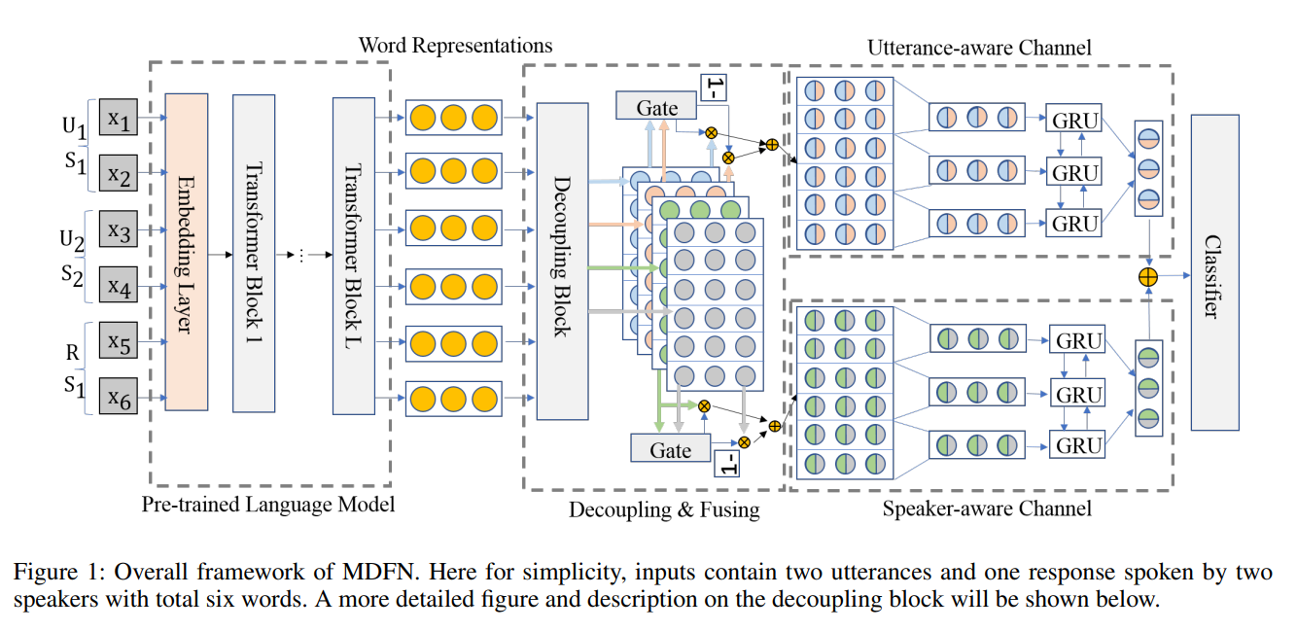
Model Overview

Slide 26
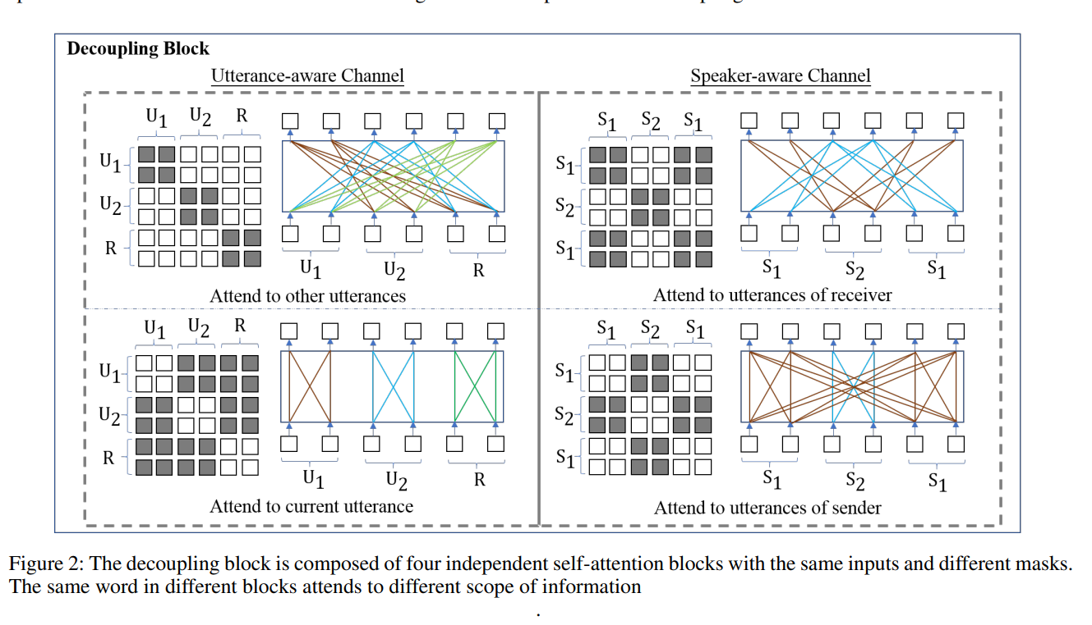
Model Overview

Slide 27





Model Architecture
Encoding Context and Response(Pre-Training)
ELECTRA (Clark et al. 2019)
Note that we also insert “ ” between every two adjacent utterances. Let , , where is respectively the length of i-th utterances and response, then the output is where k is the maximum number of utterances.

Slide 28
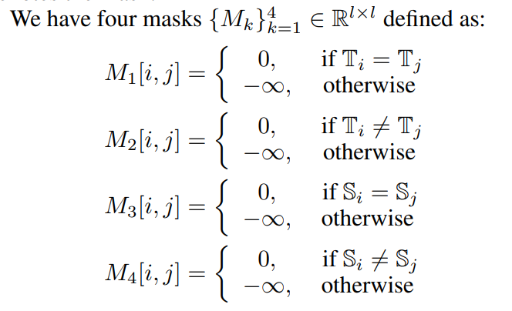
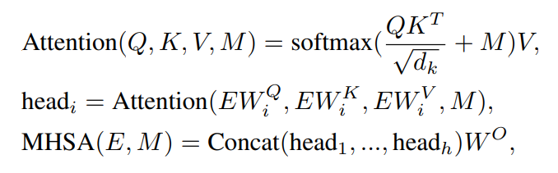

Model Architecture
Channel-aware Information Decoupling
MHSA:

Slide 29
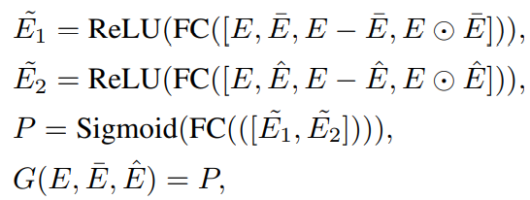
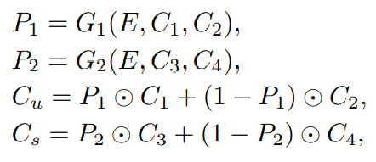
Model Architecture
Complementary Information Fusing

Slide 30
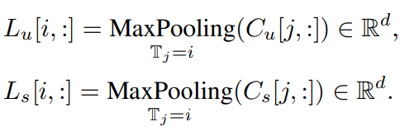
Model Architecture
Utterance Representations

Slide 31
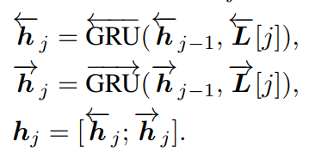


Model Architecture
Dialogue Representation
The hidden state of BiGRU at the last step as channel-aware dialogue representation. The two vectors are
The dialogue vector will be fed into a classifier with a fully connected and softmax layer.

Slide 32
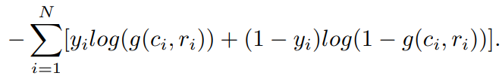
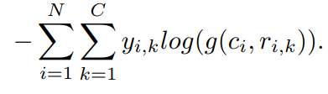
Model Architecture
Scoring and Learning
For binary classification like E-commerce, Douban and Ubuntu
For multiple choice task like MuTual:

Slide 33
Experiments
Dataset: (1) Ubuntu; (2) Douban; (3) E-commerce; (4)Mutual.
Metrics: (1) ; (2) MAP; (3)MRR.
Baseline: (1) Multi-turn matching models;
(2) PrLMs-based models.

Slide 34
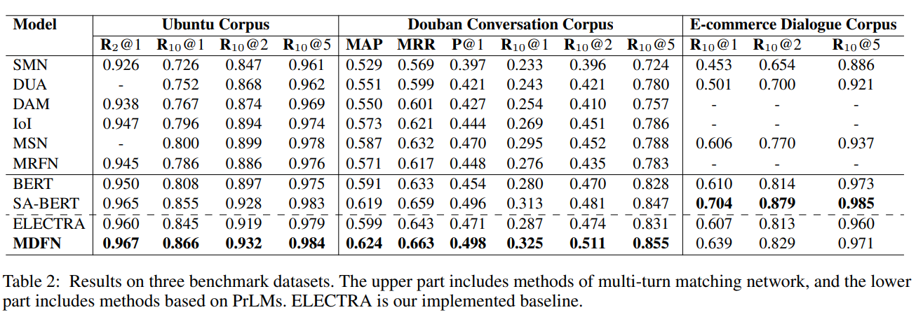
Results

Slide 35
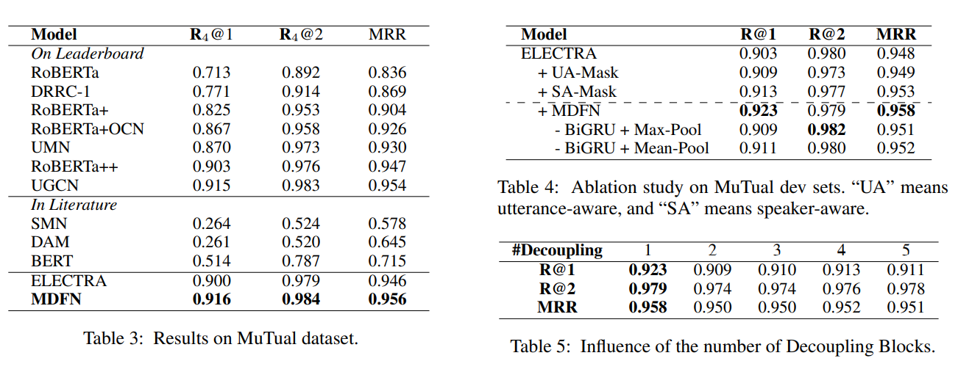
Results & Ablation Study & Number of Decoupling Layers

Slide 36
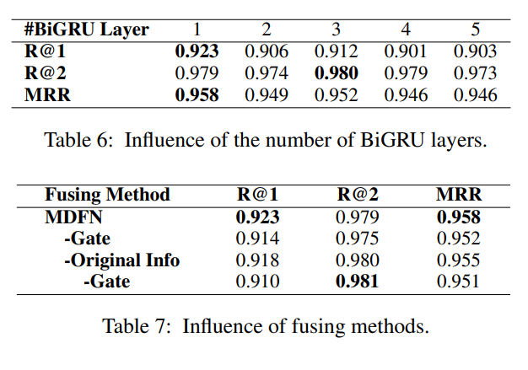
Number of BiGRU Layers & Effects of Fusing Methods

Slide 37
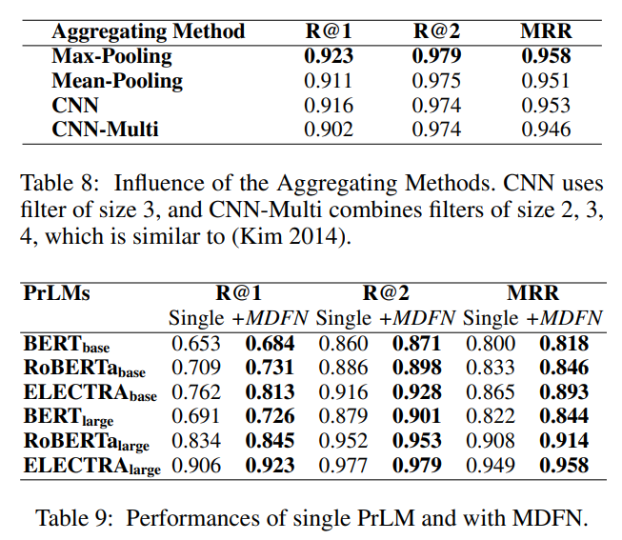
Effects of Aggregating Methods & Effects of Underlying Pre-trained Models

